Slide 1



Weda.lk
AI/ML Driven Maintenance Service Provider Matching Platform For Sri Lanka
Project ID: RP26-IT-072

Slide 2
01. Introduction
The Problem
Listing-based platforms show many service providers
Limited intelligent filtering and matching
Users must manually compare providers
Time-consuming provider selection
Risk of choosing unsuitable or unavailable providers
Proposed Solution
Component 1: Hybrid Recommendation Engine
  CF + CBF + BERT
Component 2: Temporal & Contextual Matching
  Availability + Location + Weather + Time
Component 3: Skill Verification & Credibility Scoring
  Provider skills + trustworthiness
Component 4: Sentiment & Review Credibility
  Bi-LSTM + fake review detection

Slide 3
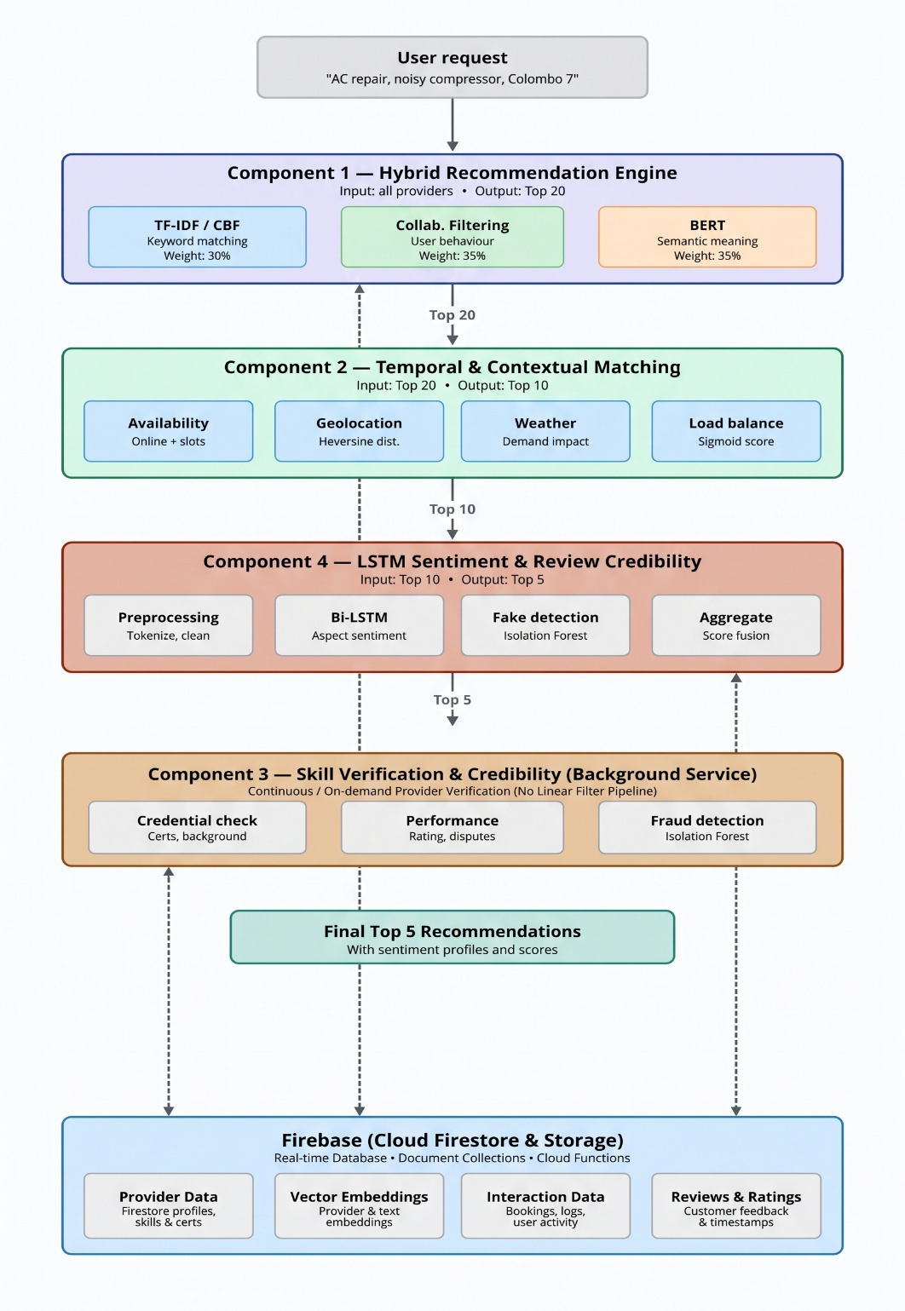
System Overview Diagram

Slide 4
02. System Video

Slide 5


IT22371836 |Hewapathirana n.t.
Hybrid – Multialgorithm Recommendation Engine
BSc (Hons) Degree in Information Technology (specialization in Information Technology)
IT223718236 | Hewapathirana N.T. | RP26-IT-072

Slide 6
Component 01: Hybrid-Multialgorithm Recommendation Engine.
Research Problem
Large number of service providers
Limited intelligent provider matching
Keyword search lacks semantic understanding
CF depends on historical interactions
Provider credibility not directly considered
Need for:
Keyword relevance
Semantic similarity
User preferences
Provider credibility
IT223718236 | Hewapathirana N.T. | RP26-IT-072

Slide 7
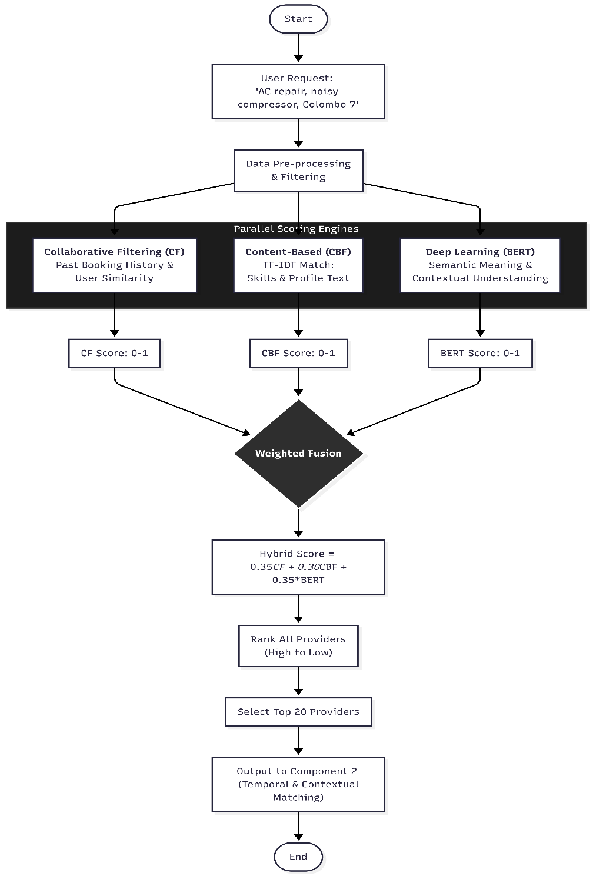
Solution Approach
1. TF-IDF Content Matching
Identifies keyword-level relevance.
Matches user request with provider descriptions.
2. Multilingual BERT Semantic Matching
Understands contextual/semantic similarity.
Handles different words with similar meanings.
Credibility-Based Collaborative Filtering
Uses historical user-provider interactions.
Incorporates provider credibility indicators.
Provides personalized recommendations.
Final Hybrid Ranking Weights
Normalize scores to 0–1 TF-IDF → 30%
Apply weighted score fusion BERT → 35%
Generate Top-20 providers CF → 35%
IT223718236 | Hewapathirana N.T. | RP26-IT-072

Slide 8

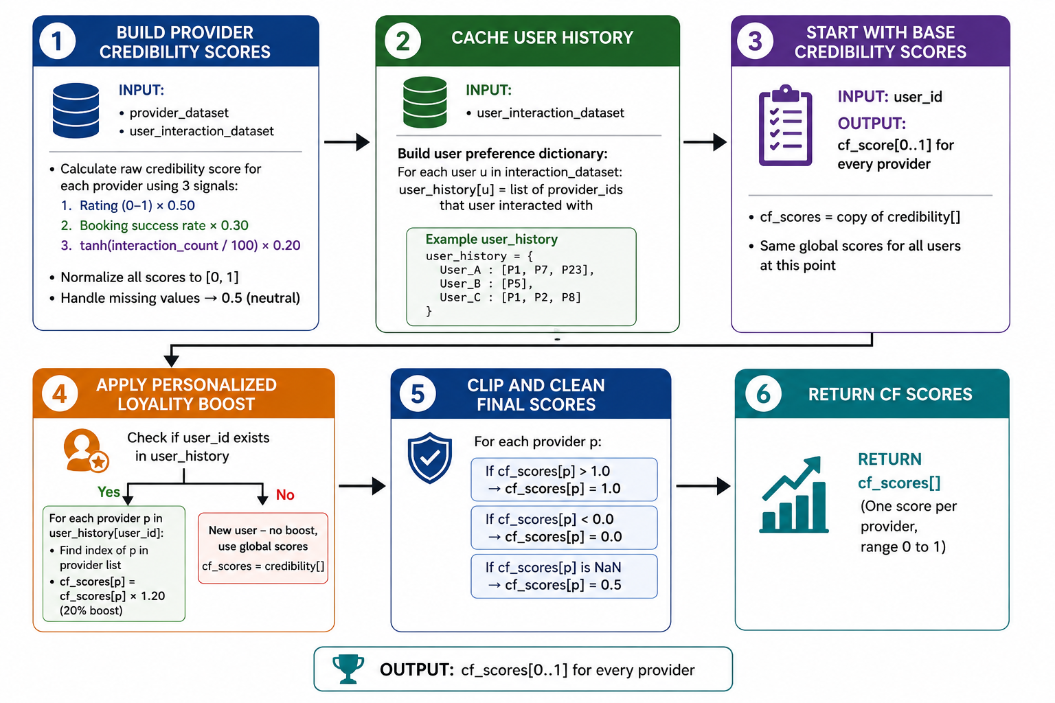
My Contribution
Developed Credibility-Based CF
Extended conventional interaction-based recommendation
Integrated provider credibility
Used three credibility signals:
  Average Rating
  Booking Success Rate
  Interaction Frequency
Added user-history personalization
Integrated TF-IDF + BERT + CF
Generated hybrid Top-20 ranking
IT223718236 | Hewapathirana N.T. | RP26-IT-072

Slide 9
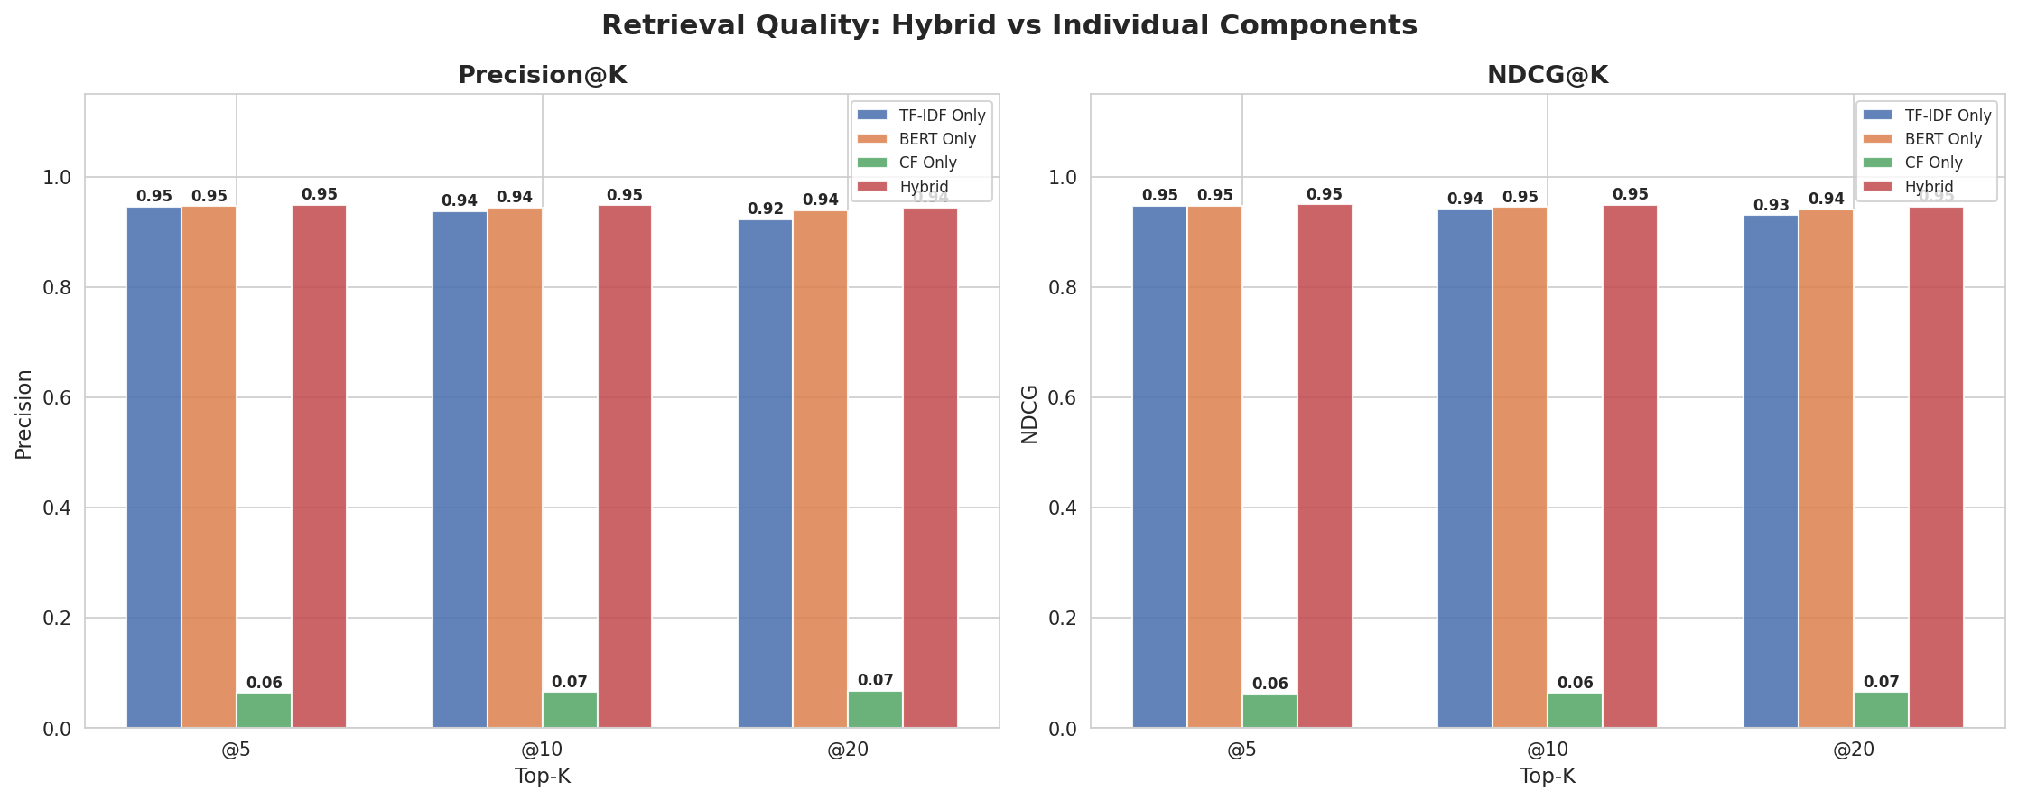

Achievement Evidence
IT223718236 | Hewapathirana N.T. | RP26-IT-072

Slide 10
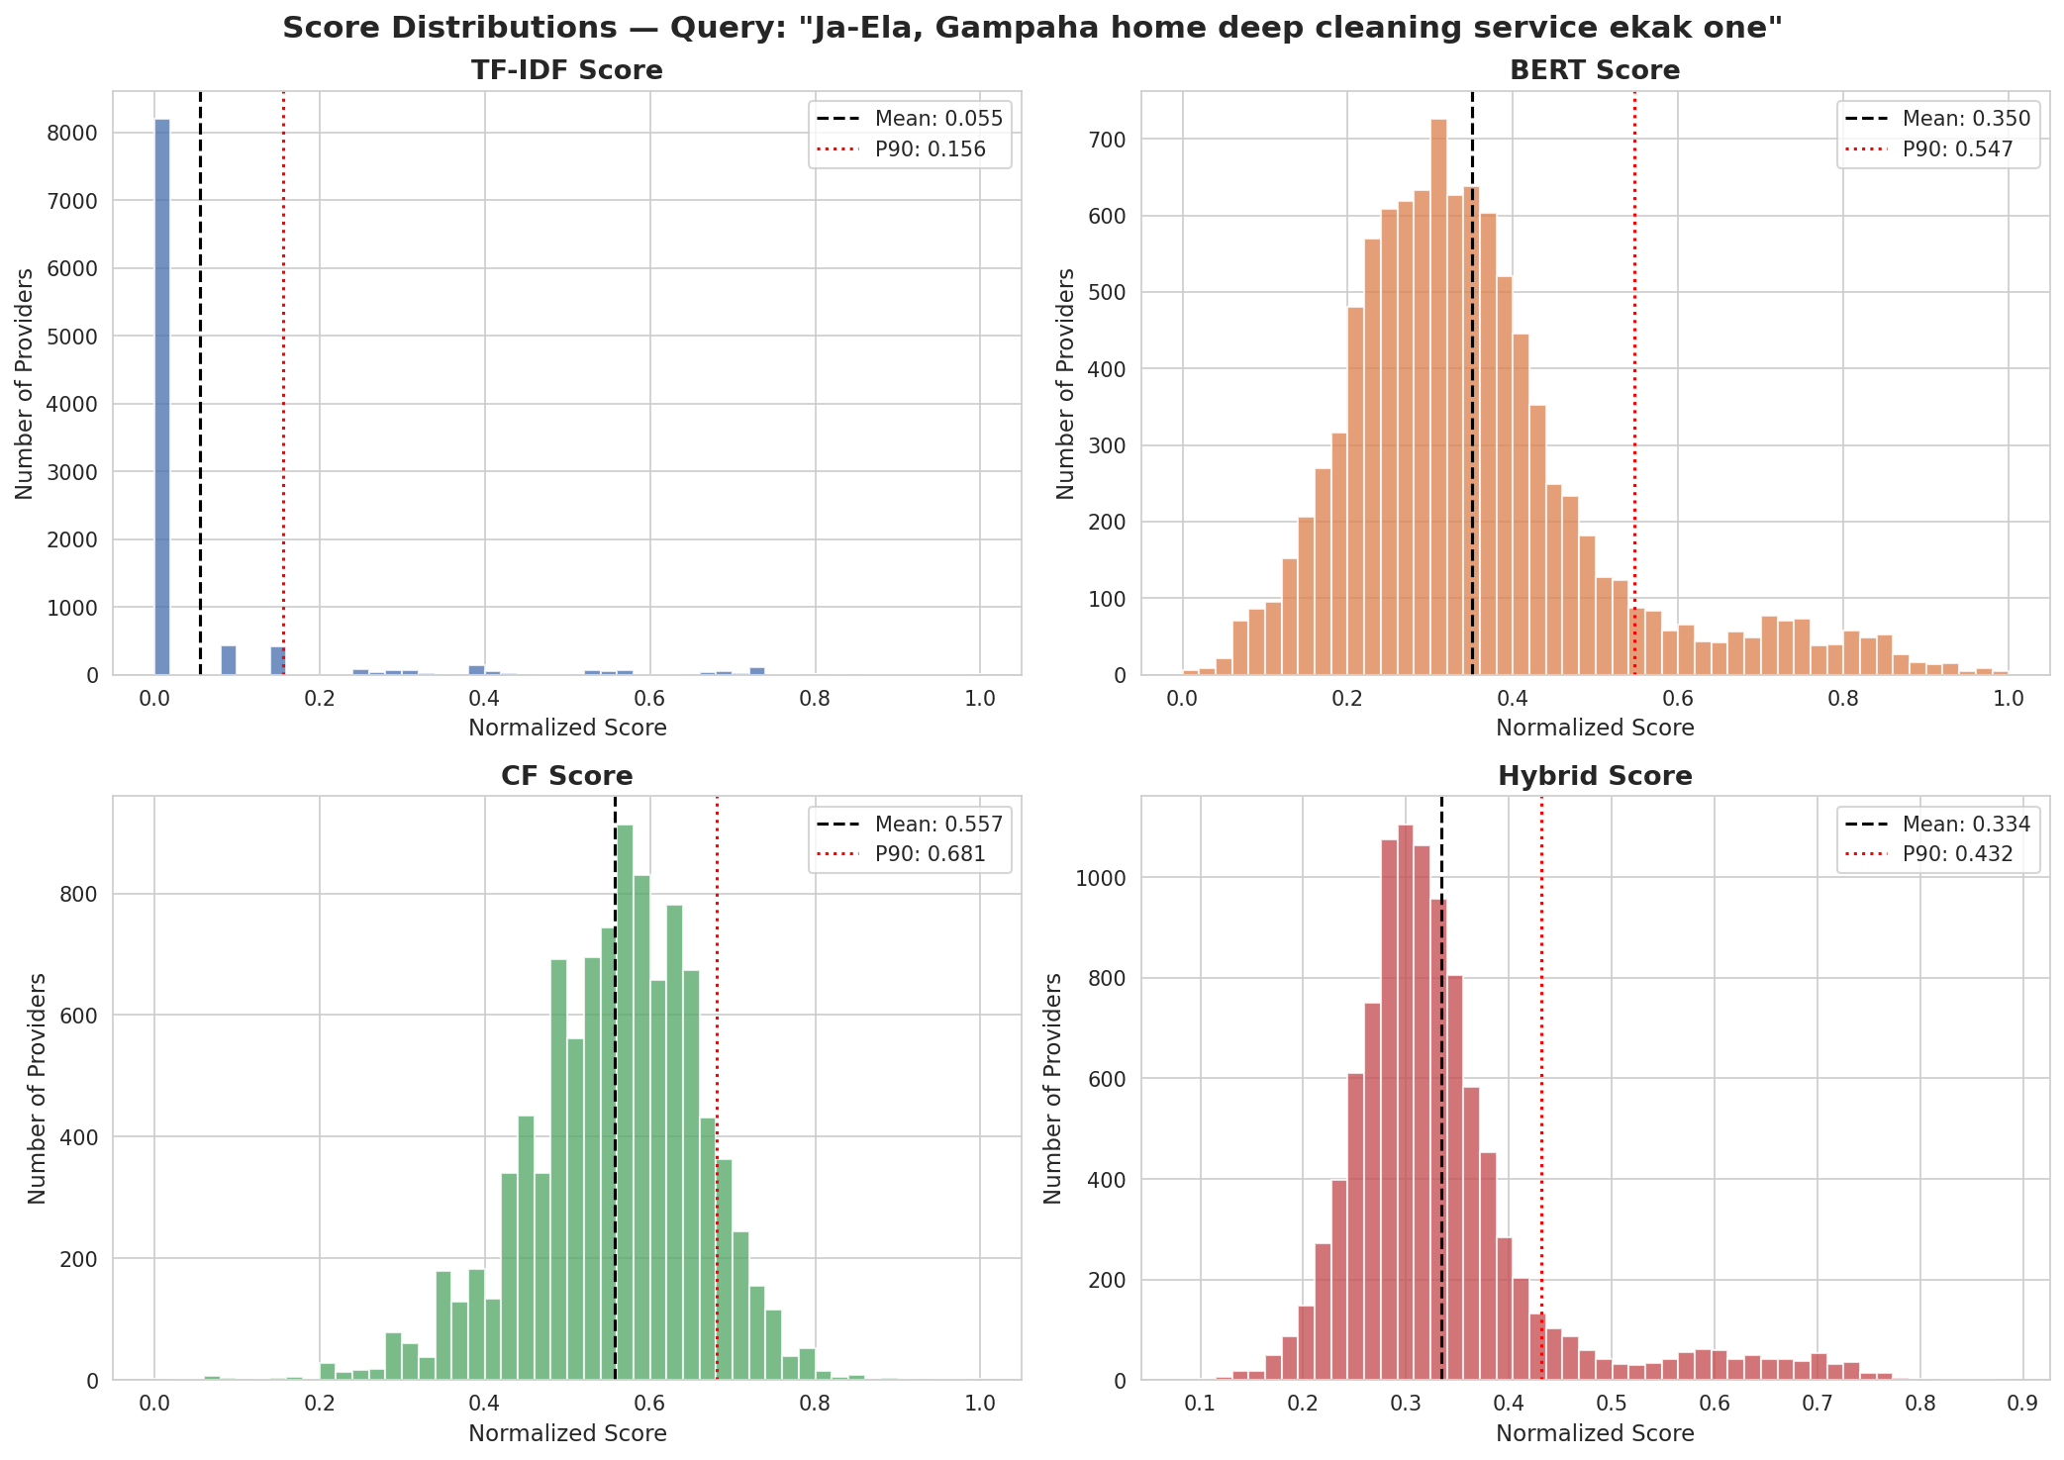
IT223718236 | Hewapathirana N.T. | RP26-IT-072

Slide 11
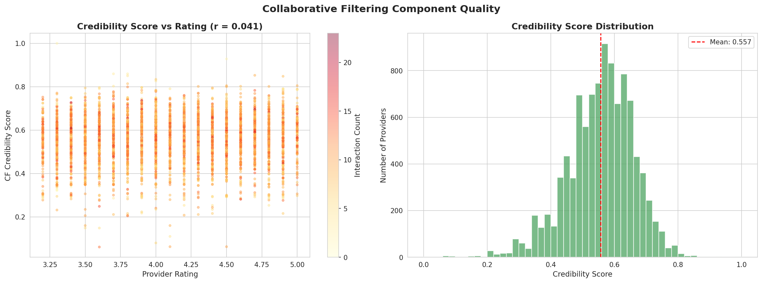
IT223718236 | Hewapathirana N.T. | RP26-IT-072

Slide 12
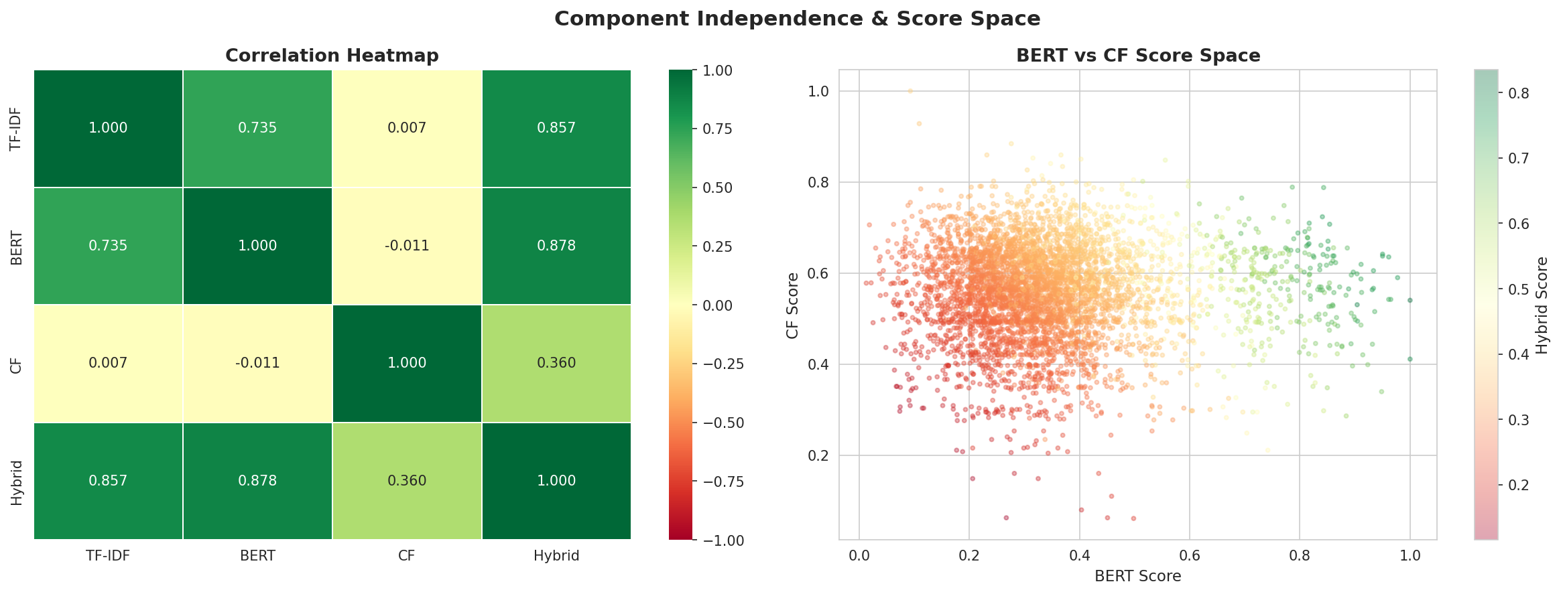
IT223718236 | Hewapathirana N.T. | RP26-IT-072

Slide 13
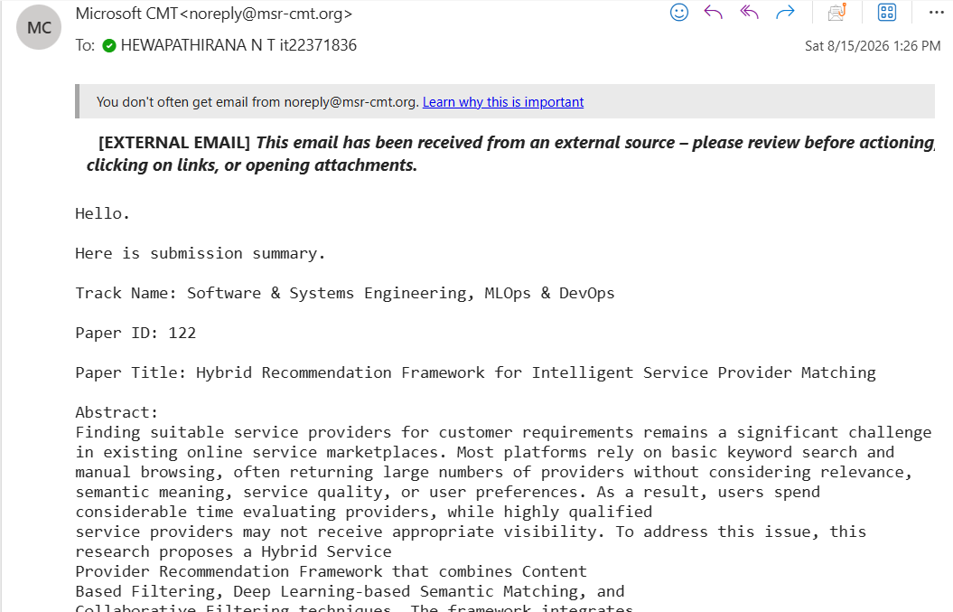
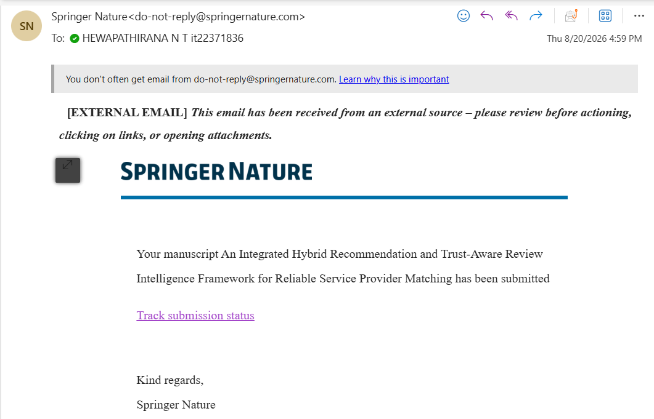
Research Paper Submission
IT223718236 | Hewapathirana N.T. | RP26-IT-072

Slide 14
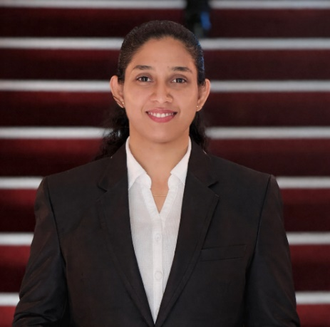

IT22190048 | Masakorala A.H.
Temporal and Contextual Matching System for Service Provider Recommendations(Availability, Location, Weather, and Time Factors).
BSc (Hons) Degree in Information Technology (specialization in Information Technology)
IT22190048 | Masakorala A.H. | RP26-IT-072

Slide 15
Component 02: Temporal and Contextual Matching System for Service Provider Recommendations(Availability, Location, Weather, and Time Factors).
Research Problem
IT22190048 | Masakorala A.H. | RP26-IT-072

Slide 16
Solution Approach
IT22190048 | Masakorala A.H. | RP26-IT-072

Slide 17
Achievement Evidence

Slide 18
IT22117182 | ROOPASINGHE EMNS
Dynamic Skill Verification & Provider Credibility Scoring Model
BSc (Hons) Degree in Information Technology (specialization in Information Technology)
IT22117182 | ROOPASINGHE EMNS | RP26-IT-072

Slide 19
Component 03:Dynamic Skill Verification & Provider Credibility Scoring Model
Research Problem
IT22117182 | ROOPASINGHE EMNS | RP26-IT-072

Slide 20
Solution Approach
IT22117182 | ROOPASINGHE EMNS | RP26-IT-072

Slide 21
Achievement Evidence

Slide 22


IT22914200|Tharushika w.a.m.
Bi-LSTM Based Sentiment Analysis & Review Credibilty Module
BSc (Hons) Degree in Information Technology (specialization in Information Technology)
IT22914200 | Tharushika W.A.M. | RP26-IT-072

Slide 23

Component 04: Bi-LSTM Based Sentiment Analysis & Review Credibility Module
Research Problem
Heavy reliance on overall ratings
Limited aspect-level service evaluation
Reviews may be suspicious or unreliable
Sentiment & credibility often analyzed separately
Lack of trust-aware provider ranking
Need to identify trustworthy providers, not just highly rated ones
IT22914200 | Tharushika W.A.M. | RP26-IT-072

Slide 24
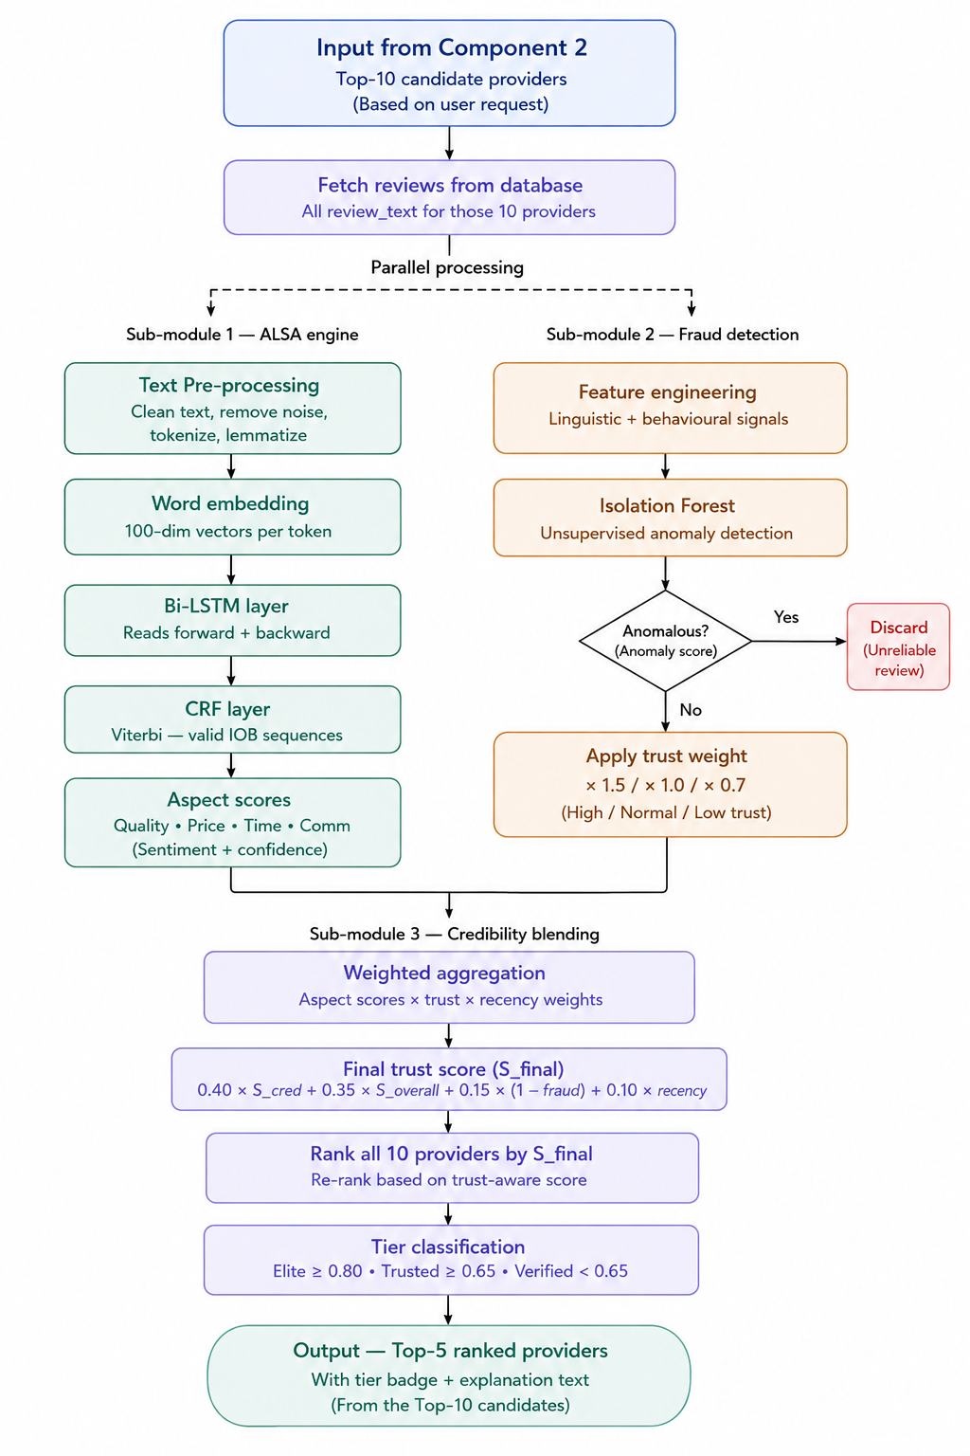
Solution Approach
Receive Top-10 candidates from Component 2
Analyze customer reviews
Multi-Task Bi-LSTM + Multi-Head Attention → Aspect Sentiment
Isolation Forest → Review Credibility
CATF → Fuse Sentiment + Trust Signals
Calculate Provider Trust Score
Re-rank candidate providers
Return Top-5 Trustworthy Providers
IT22914200 | Tharushika W.A.M. | RP26-IT-072

Slide 25
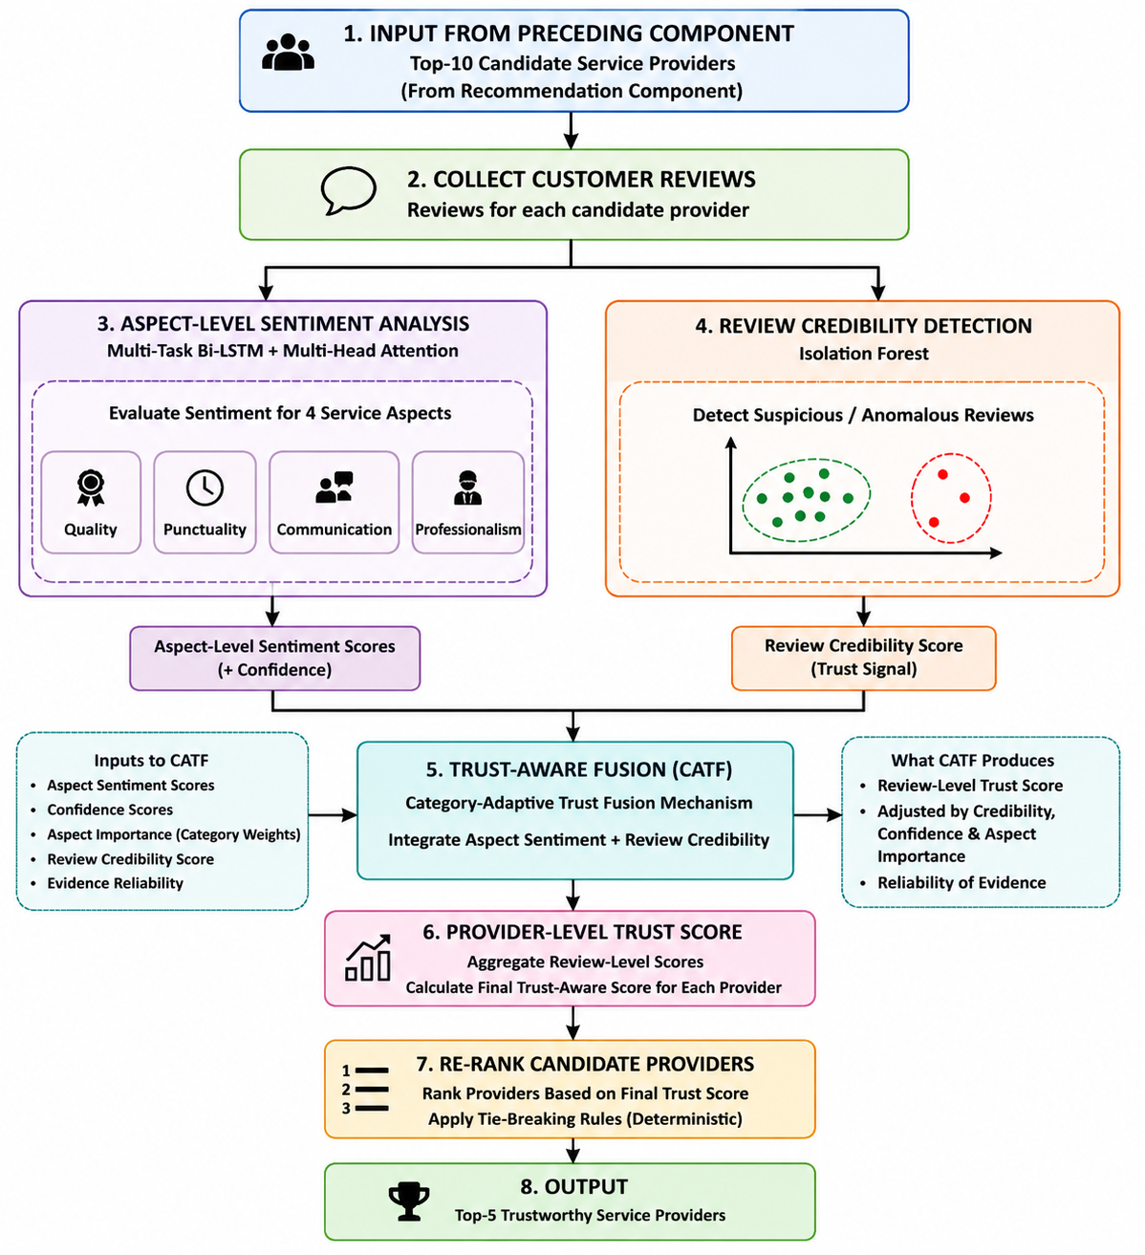

My Contribution
Developed a Trust-Aware Review Intelligence component
Integrated aspect-level sentiment with review credibility
Evaluated 4 service-quality aspects
Applied Multi-Task Bi-LSTM + Multi-Head Attention
Applied Isolation Forest for suspicious review detection
Proposed CATF-based trust-aware fusion
Calculated provider-level trust scores
Re-ranked candidates to generate the Final Top-5 providers
IT22914200 | Tharushika W.A.M. | RP26-IT-072

Slide 26
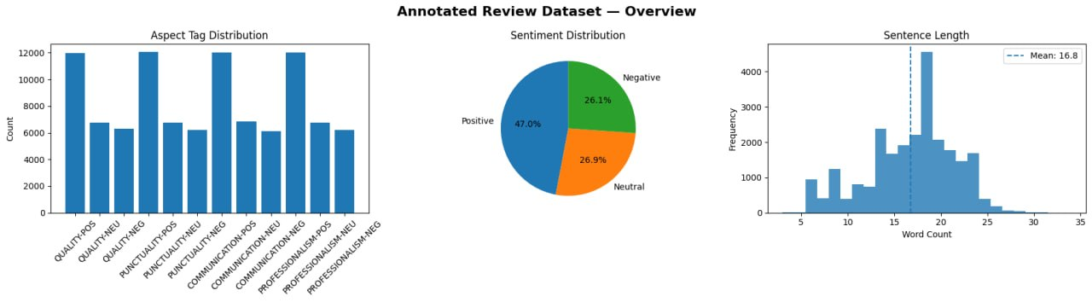
Achievement Evidence
IOB Annotated Reviews
IT22914200 | Tharushika W.A.M. | RP26-IT-072

Slide 27
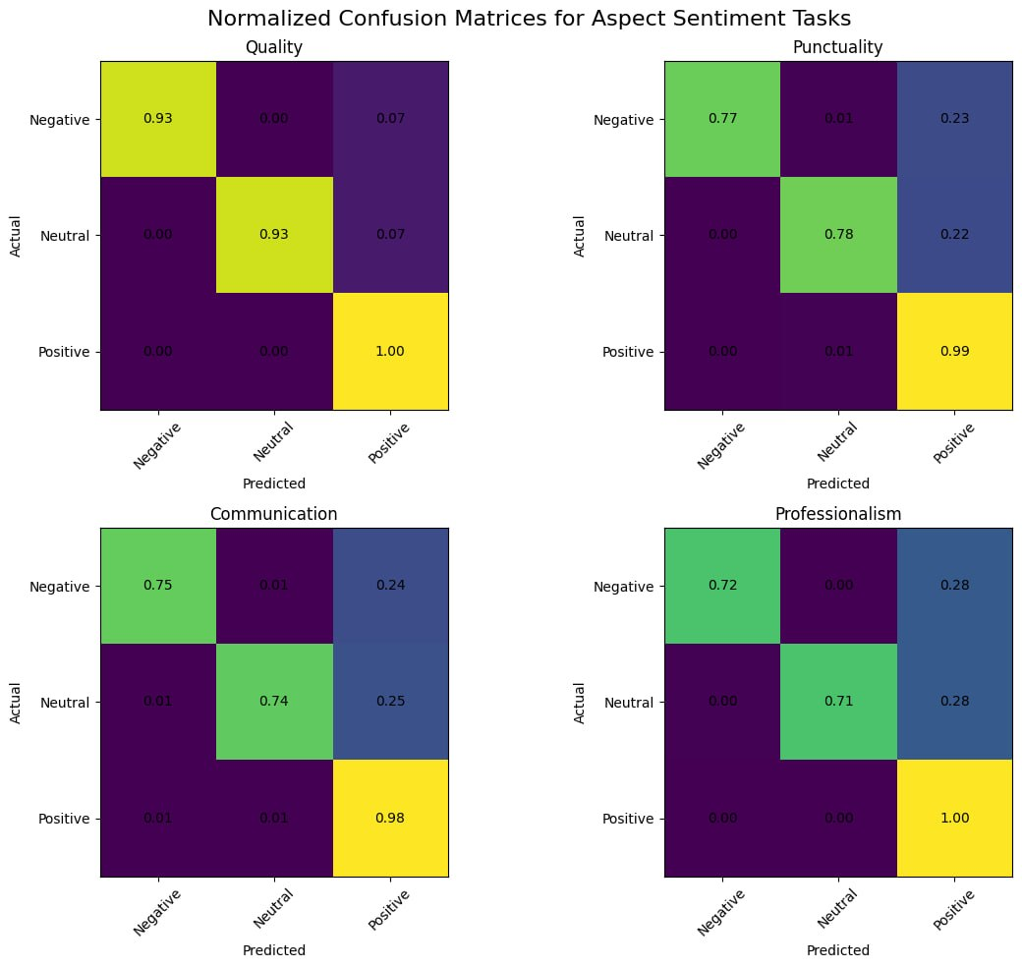
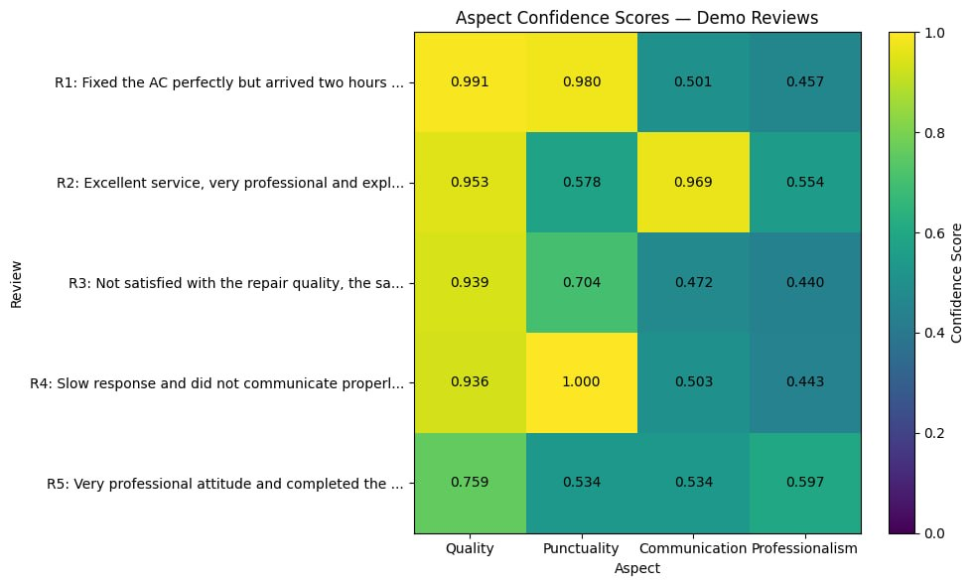
LSTM-Based Sentiment & Review Credibility Module
IT22914200 | Tharushika W.A.M. | RP26-IT-072

Slide 28
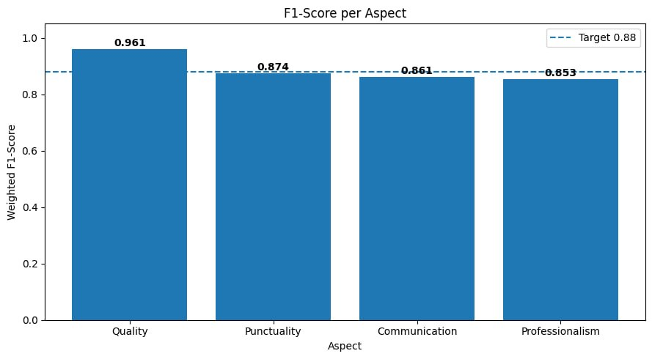
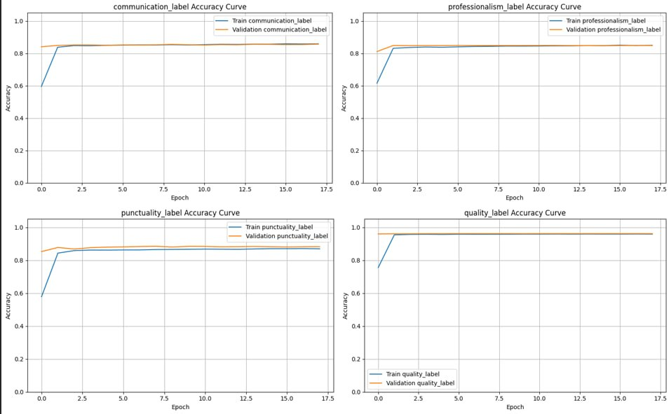
IT22914200 | Tharushika W.A.M. | RP26-IT-072

Slide 29
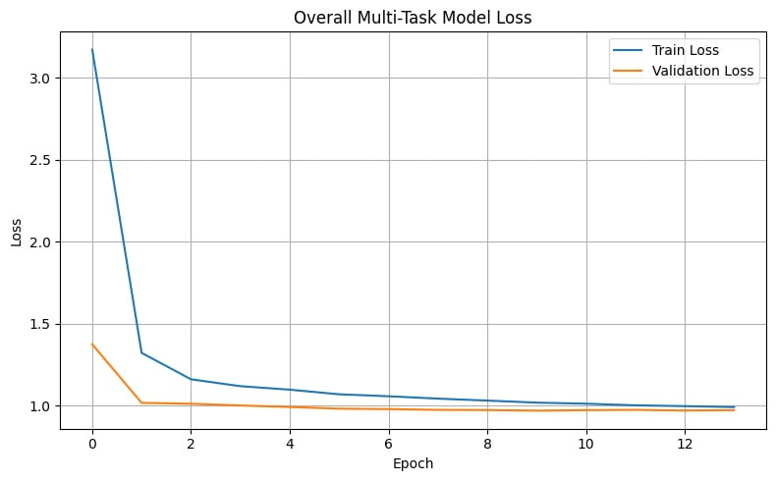
IT22914200 | Tharushika W.A.M. | RP26-IT-072

Slide 30

Thank You!

